Slide 1
Online Shopping Service
1
Team 01: Emily Benson & Nick Hancher

Slide 2
Analysis Phase
2

Slide 3
Analysis Phase: 10 online shopping systems
3
Amazon.com
Bestbuy.com
Dell.com
Newegg.com
Walmart.com
JCPenney.com
Ebay.com
Target.com
Walgreens.com
CVS.com

Slide 4
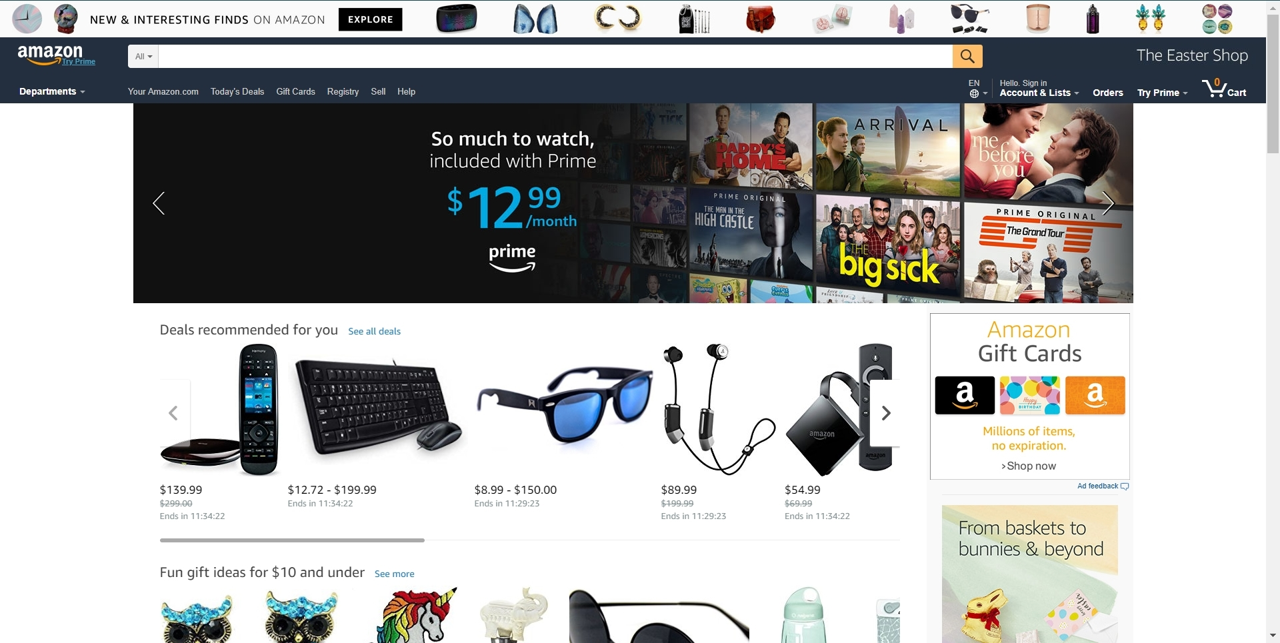
Amazon.com
4
Sub-Functions
Login
Logout
Input Address
Input Payment Method
Add product to cart
Signup
View cart
Update cart
View Department
Add item
Update price
Update //database
Connect //database
Store //database
Search
View Orders
View Lists
Update Lists
Class Objects
User Accounts
Carts
Departments
System Admins
Business Accounts
Databases
Hardware
Protocols
Your Orders
Your Lists

Slide 5
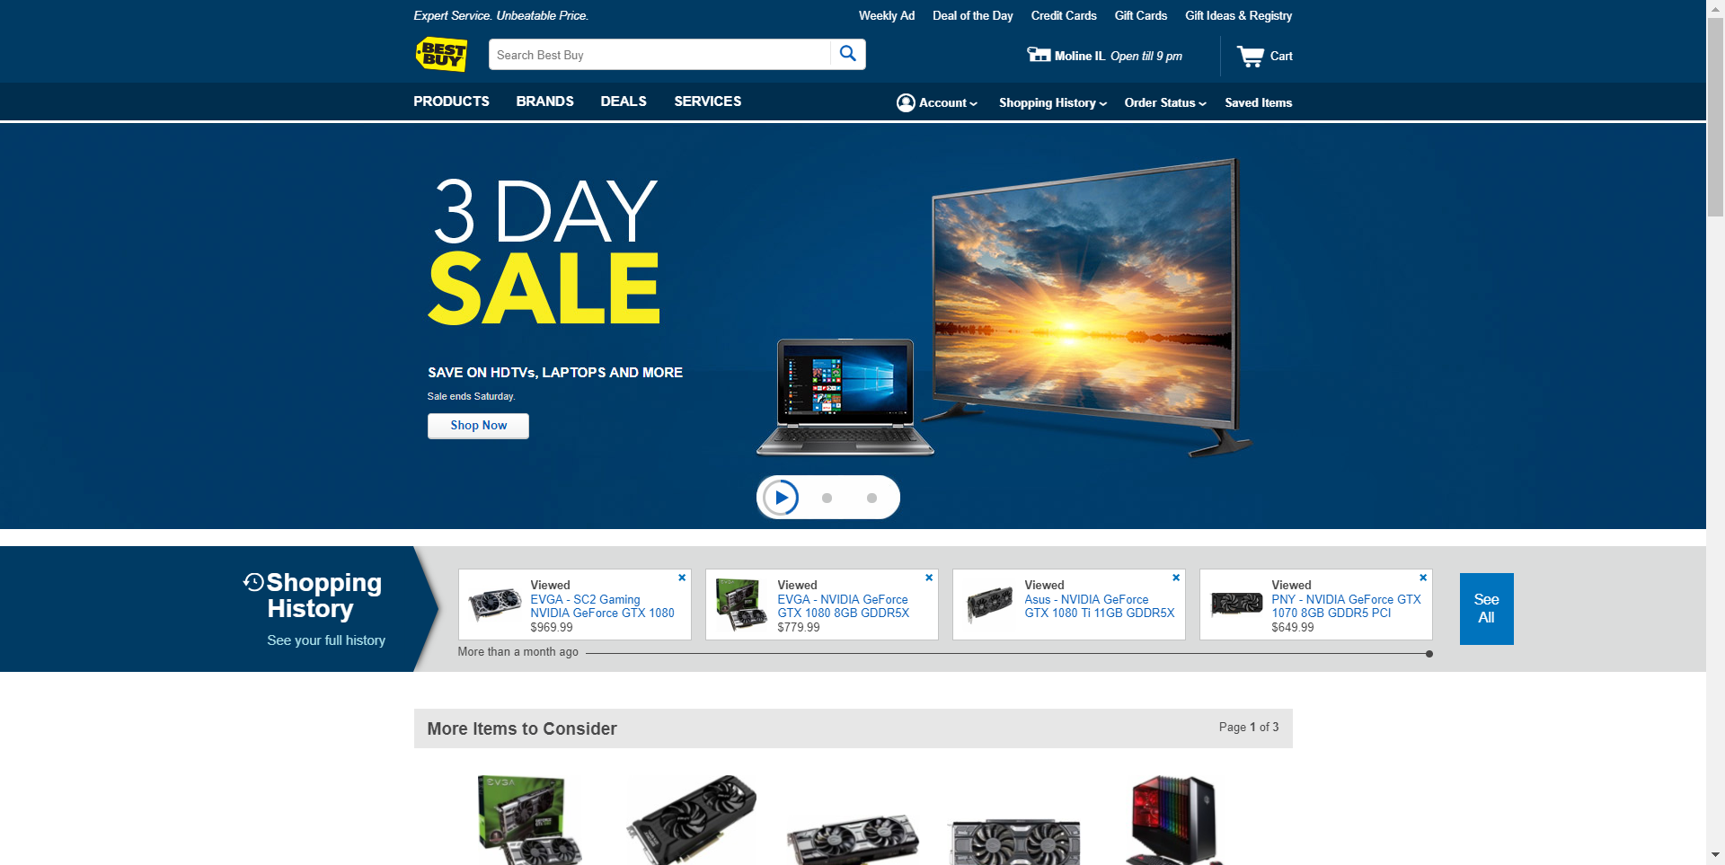
BestBuy.com
5
Sub-Functions
Login
Logout
Input Address
Input Payment Method
Add product to cart
Signup
Update
Connect
Store
View Brand
Make an appointment
Track a repair
Schedule a service
View Deals
Display
Find Store
Add Store
Class Objects
User Accounts
Carts
Categories
System Admins
Databases
Hardware
Protocols
Brands
Services
Deals
Stores

Slide 6
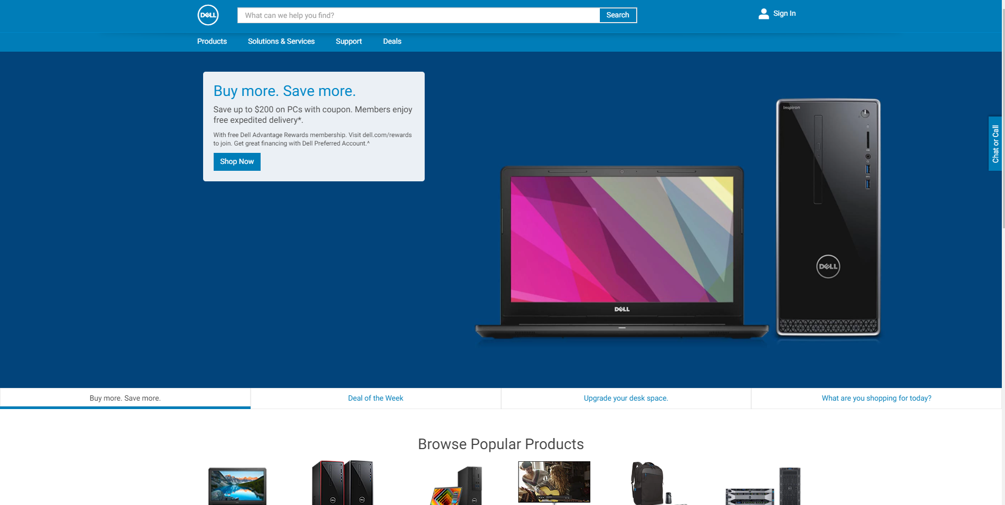
Dell.com
6
Sub-Functions
Login
Logout
Input Address
Input Payment Method
Add product to cart
Signup
Update
Connect
Store
Display
View Deals
View Solutions and Services
Request Support
Update Deals
View Support Library
Class Objects
User Accounts
Carts
Categories
System Admins
Databases
Hardware
Protocols
Support
Deals
Solutions & Services

Slide 7
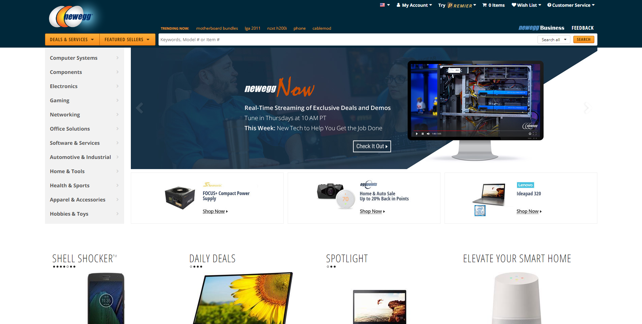
Newegg.com
7
Sub-Functions
Login
Logout
Input Address
Input Payment Method
Add product to cart
Signup
Update
Connect
Store
Display
Find Invoice
Return an item
Track an Order
View Deals
Update Deals
Add Product
Update product price
Class Objects
User Accounts
Carts
Categories
System Admins
Databases
Hardware
Protocols
Support
Deals
Solutions & Services

Slide 8
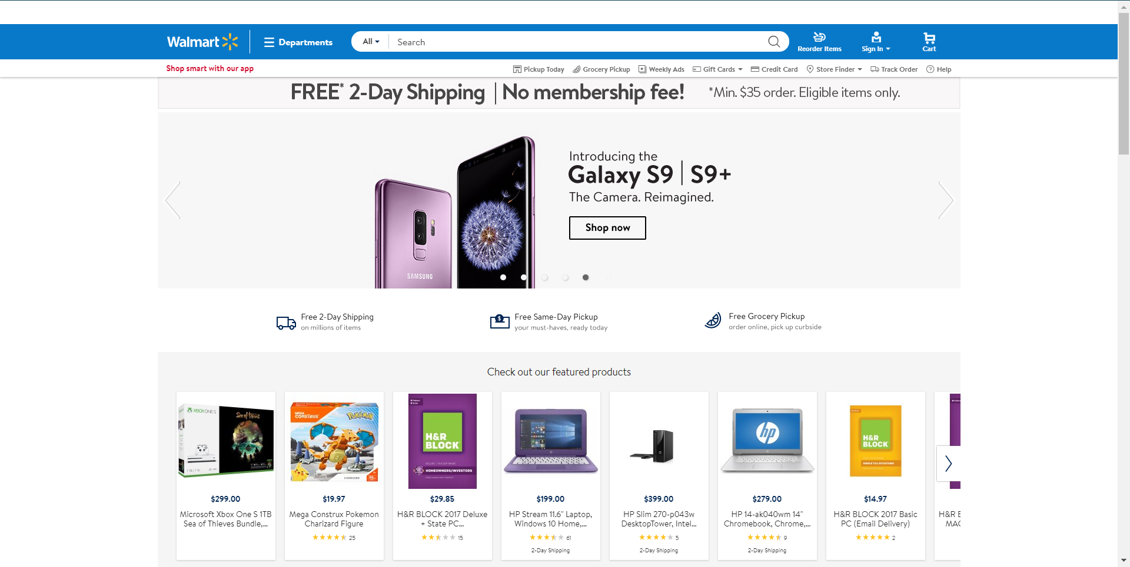
Walmart.com
8
Sub-Functions
Login
Logout
Input Address
Input Payment Method
Add product to cart
Signup
Update
Connect
Store
Add product
Update Product price
Display
Find Store
Add Store
Update List
View List
View Cart
Class Objects
User Accounts
Carts
Departments
System Admins
Business Accounts
Databases
Hardware
Protocols
Stores
Lists

Slide 9
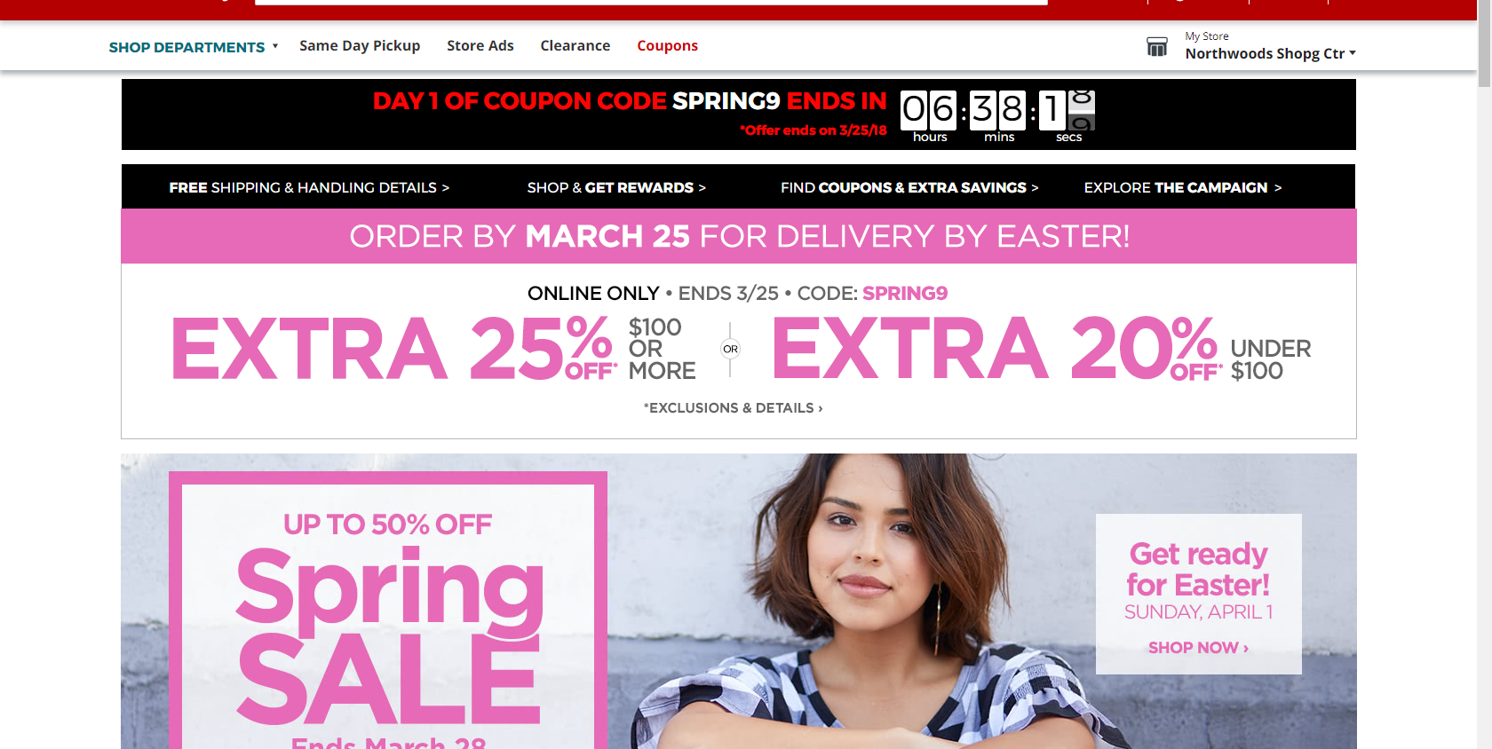
JCPenney.com
9
Sub-Functions
Login
Logout
View Cart
Edit Cart
Sign Up
View Department
Find Store
Sign up for Rewards
Track Order
Update //database
Connect //database
Store //database
View Rewards
Search
Check Balance
Class Objects
User Accounts
Carts
Departments
System Admins
Coupons
Databases
Hardware
Protocols
Customer Service
JCPenney Credit Card(Rewards)

Slide 10
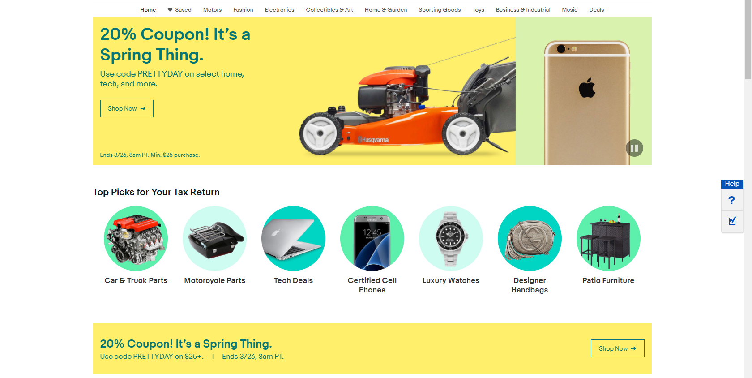
Ebay.com
10
Sub-Functions
Login
Logout
View Cart
Edit Cart
Sign Up
View Department
Start selling
Connect to Social Media
View Company info
Search
Update //database
Connect //database
Store //database
Learn to Sell
Class Objects
User Accounts
Carts
Departments
System Admins
Gift Cards
Databases
Hardware
Protocols
Sell
Tools & Apps

Slide 11
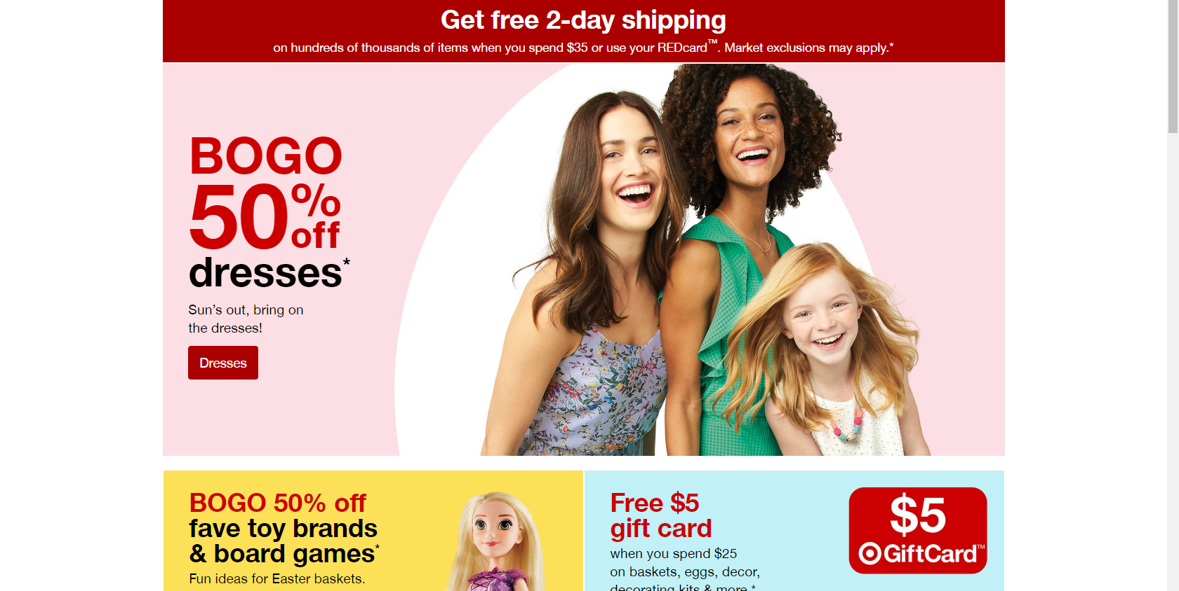
Target.com
11
Sub-Functions
Login
Logout
View Cart
Edit Cart
Sign Up
View Categories
Update //database
Connect //database
Store //database
Find Store
Track Order
Feedback
See all Help
Contact us
Class Objects
User Accounts
Carts
Categories
System Admins
Registries & Lists
Databases
Hardware
Protocols
Gift Cards
Sales

Slide 12
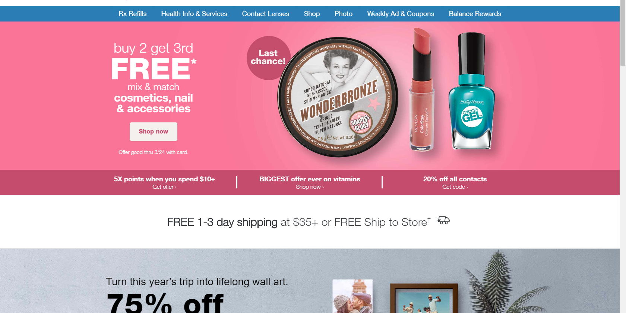
Walgreens.com
12
Sub-Functions
Login
Logout
View Cart
Edit Cart
Track Package
View Categories
Update //database
Connect //database
Store //database
Sign Up
Find Store
Search
View Balance Rewards
View Deals
Contact us
Class Objects
User Accounts
Carts
Shop
System Admins
Photo
Databases
Hardware
Protocols
Rx Refills
Balance Rewards

Slide 13
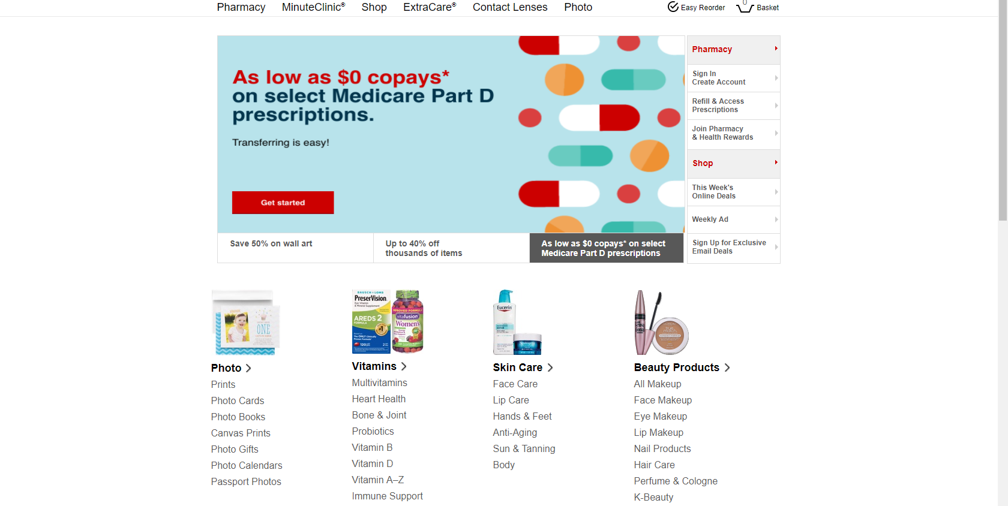
CVS.com
13
Sub-Functions
Login
Logout
View Basket
Edit Basket
Find Store
Sign Up
Update //database
Connect //database
Store //database
Search
Order Status
Refill Prescription
Online Deals
ExtraCare(Rewards)
View Departments
Class Objects
User Accounts
Basket
Shop
System Admins
Databases
Hardware
Protocols
Pharmacy
Photo
Deals

Slide 14
Analysis of common Class Objects
14

Slide 15
Common COs For Amazon
15
Objects | Amazon | BestBuy | Dell | NewEgg | Walmart | JCPenney | Ebay | Target | Walgreens | CVS | %
User Accounts | + | + | + | + | + | + | + | + | + | + | 100%
Carts | + | + | + | + | + | + | + | + | + | + | 100%
Departments | + | + | + | + | + | + | + | + | + | + | 100%
System Admins | + | + | + | + | + | + | + | + | + | + | 100%
Business Accounts | + |  |  | + | + |  |  |  |  |  | 30%
Databases | + | + | + | + | + | + | + | + | + | + | 100%
Hardware | + | + | + | + | + | + | + | + | + | + | 100%
Protocols | + | + | + | + | + | + | + | + | + | + | 100%
Your Orders | + | + | + | + | + | + | + | + | + | + | 100%
Your Lists | + |  |  |  | + |  |  | + |  |  | 30%

Slide 16
Additional Common COs For Best Buy
16
Objects | Amazon | BestBuy | Dell | NewEgg | Walmart | JCPenney | Ebay | Target | Walgreens | CVS | %
Brands |  | + |  |  |  |  |  |  |  |  | 10%
Services | + | + | + |  | + | + |  | + | + | + | 80%
Deals | + | + | + | + | + | + | + | + | + | + | 100%
Stores | + | + | + |  | + | + |  | + | + | + | 80%

Slide 17
Additional Common COs For Dell, JCPenney & Ebay
17
Objects | Amazon | Best Buy | Dell | NewEgg | Walmart | JCPenney | Ebay | Target | Walgreens | CVS | %
Support | + | + | + | + | + | + | + | + | + | + | 100%
Rewards |  |  |  |  |  | + |  | + | + | + | 40%
Gift Cards |  |  |  |  |  |  | + | + |  |  | 20%
Sell |  |  |  |  |  |  | + |  |  |  | 10%
Tools |  |  |  |  |  |  | + |  |  |  | 10%

Slide 18
Additional Common COs For Walgreens & CVS
18
Objects | Amazon | Best Buy | Dell | NewEgg | Walmart | JCPenney | Ebay | Target | Walgreens | CVS | %
Photo |  |  |  |  |  |  |  |  | + | + | 20%
Rx Refills |  |  |  |  |  |  |  |  | + |  | 10%
Pharmacy |  |  |  |  |  |  |  |  |  | + | 10%

Slide 19
Class Object Outcomes
19
Objects for the System
User Accounts
Carts
Departments
System Admins
Databases
Hardware
Protocols
Orders
Deals
Support
Services
Stores
Rewards
Gift Cards
Business Account

Slide 20
Analysis of Common Sub-Functions
20

Slide 21
21
Functions | Amazon | Bestbuy | Dell | Newegg | Walmart | JCPenny | Ebay | Target | Walgreens | CVS | Percentage
Login | + | + | + | + | + | + | + | + | + | + | 100
Logout | + | + | + | + | + | + | + | + | + | + | 100
Input address | + | + | + | + | + | + | + | + | + | + | 100
Input payment Method | + | + | + | + | + | + | + | + | + | + | 100
Add product to cart | + | + | + | + | + | + | + | + | + | + | 100
Signup | + | + | + | + | + | + | + | + | + | + | 100
View cart/view basket | + | + | + | + | + | + | + | + | + | + | 100
Update cart/edit basket | + | + | + | + | + | + | + | + | + | + | 100
View Department | + | + |  | + | + | + | + | + | + | + | 90
Add item | + | + | + | + | + | + | + | + | + | + | 100
Update price | + | + | + | + | + | + | + | + | + | + | 100

Slide 22
22
Functions | Amazon | Bestbuy | Dell | Newegg | Walmart | JCPenny | Ebay | Target | Walgreens | CVS | Percentage
Update | + | + | + | + | + | + | + | + | + | + | 100
Connect | + | + | + | + | + | + | + | + | + | + | 100
Store | + | + | + | + | + | + | + | + | + | + | 100
Search | + | + |  | + | + | + | + | + | + | + | 90
View Orders | + | + | + | + | + | + | + | + | + | + | 100
View Lists | + |  |  |  | + | + |  |  |  |  | 30
Update Lists | + |  |  |  | + | + |  |  |  |  | 30
View Brands |  | + |  | + | + | + | + | + | + | + | 80
Make an appointment |  | + |  |  |  |  |  |  |  |  | 10
Track a repair |  | + |  |  | + |  |  |  |  |  | 20
Schedule a Service |  | + |  |  | + |  |  |  |  |  | 20

Slide 23
23
Functions | Amazon | Bestbuy | Dell | Newegg | Walmart | JCPenny | Ebay | Target | Walgreens | CVS | Percentage
View Deals |  | + |  | + | + | + | + | + | + | + | 80
Display | + | + | + | + | + | + | + | + | + | + | 100
Find Store |  | + |  |  | + | + |  | + | + | + | 60
Add Sore |  | + |  |  | + | + |  | + | + | + | 60
View Solutions and Services |  |  | + |  |  |  |  |  |  |  | 10
Request Support |  |  | + |  |  |  |  |  |  |  | 10
Update Deals |  | + | + | + | + |  |  | + | + |  | 60
View Support Library |  |  | + |  |  |  |  |  |  |  | 10
Find Invoice |  |  |  | + |  |  |  |  |  |  | 10
Return an item | + | + | + | + | + | + | + | + | + | + | 100
Track an Order | + | + | + | + | + | + | + | + | + | + | 100

Slide 24
24
Functions | Amazon | Bestbuy | Dell | Newegg | Walmart | JCPenny | Ebay | Target | Walgreens | CVS | Percentage
Enroll in Rewards |  |  |  |  |  | + |  | + | + | + | 40
View Rewards |  |  |  |  |  | + |  | + | + | + | 40
Search | + | + | + | + | + | + | + | + |  | + | 90
Check Balance |  |  |  |  |  | + |  |  |  |  | 10
Start selling |  |  |  |  |  |  | + |  |  |  | 10
Connect to Social Media |  |  |  |  |  |  | + |  |  |  | 10
View Company info | + | + | + | + | + | + | + | + | + | + | 100
Learn to sell |  |  |  |  |  |  | + |  |  |  | 10
View Categories | + |  | + | + | + | + | + |  | + | + | 80
Feedback | + | + | + | + | + | + | + | + | + | + | 100
See all Help | + | + | + | + | + | + | + | + | + | + | 100

Slide 25
25
Functions | Amazon | Bestbuy | Dell | Newegg | Walmart | JCPenney | Ebay | Target | Walgreens | CVS | Percentage
Contact us | + | + | + | + | + | + | + | + | + | + | 100
Refill Prescription |  |  |  |  | + | + |  |  | + | + | 40
Order Status | + | + | + | + | + | + |  | + | + | + | 90

Slide 26
Sub-Functions Outcomes
26
Functions for the System
Login
Logout
Input Address
Input payment method
Edit Cart
Sign Up
View Cart
Find a Store
Search
Contact Us
Track Order
View Rewards
View Departments
View Deals
Sign Up for Rewards

Slide 27
Our Design
27

Slide 28
Customer Requirements
28
Objective:
Create an online shopping service with an automatic drone delivery service.
Supporting Systems and System Constraints:
Servers to host the site and manage a high amount of user traffic.
Clients will need a reliable internet connection to access the site.

Slide 29
Functions
29
1. Login
2. Logout
3. Input Address
4. Input Payment Method
5. Edit Cart
6. Sign Up
7. View Cart
8. Find Store
9. Add Store
10. Remove Store
11. Search
12. Contact Us
13. Add/Edit Item
14. Remove Item
15. View Item
16. Track Order
17. View Rewards
18. Add Rewards
19. Use Rewards
20. View Departments
21. Edit Department
22. View Deals
23. Add Deal
24. Remove Deal
25. Sign Up for Rewards
26. Compare Competition’s Prices
27. Match Competitor’s Price
28. Update Competitor’s Price
29. View Electronics Compatibility
30. Edit Electronics Compatibility
31. Add/Edit Ticket
32. View Order
33. Edit Order

Slide 30
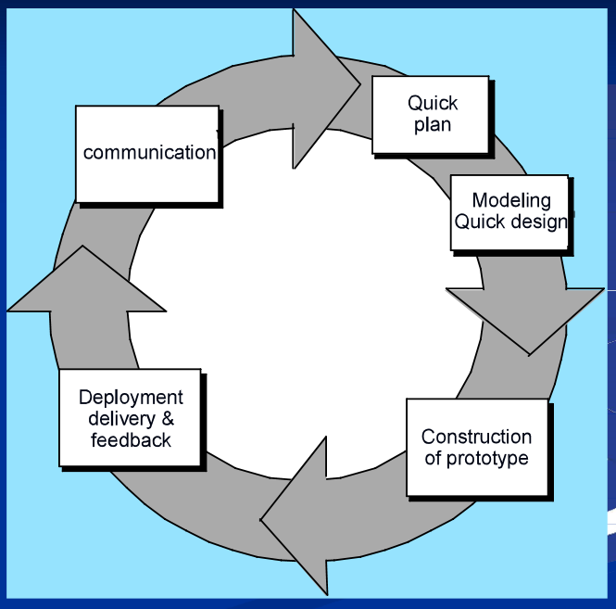
Software Engineering Process Model: Prototyping Model
30
The Evolutionary prototyping model will be used to create a rough prototype of the system and continuously refine it as development continues.
The product needs to work as intended from day one. This model will allow for tester feedback to find and work out the majority of the bugs before launch.

Slide 31
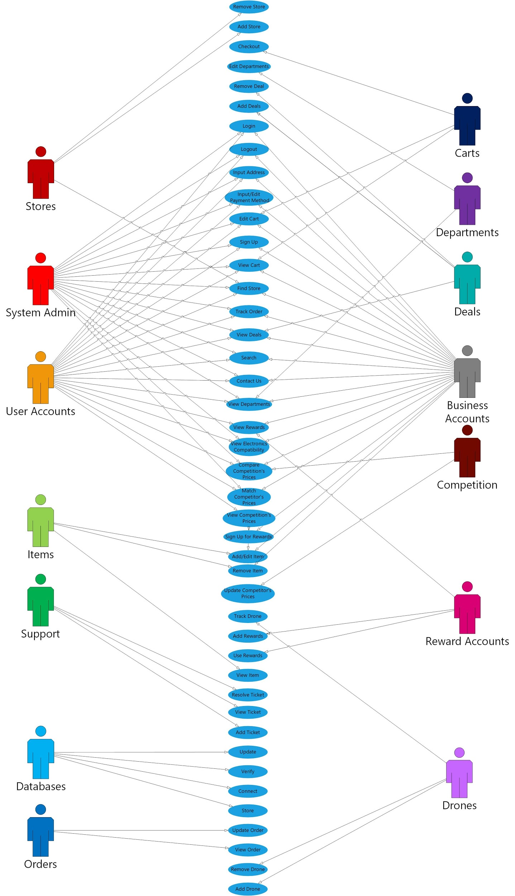
Use Case Diagram
31

Slide 32
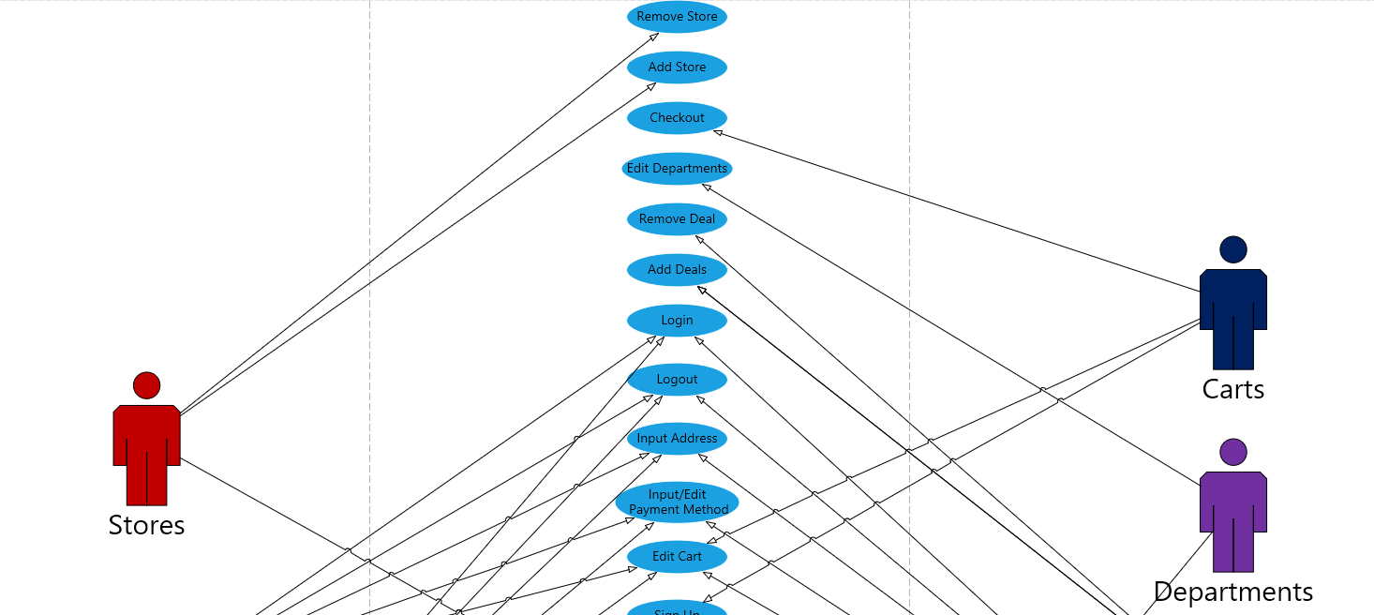
Use Case Part 1
32

Slide 33
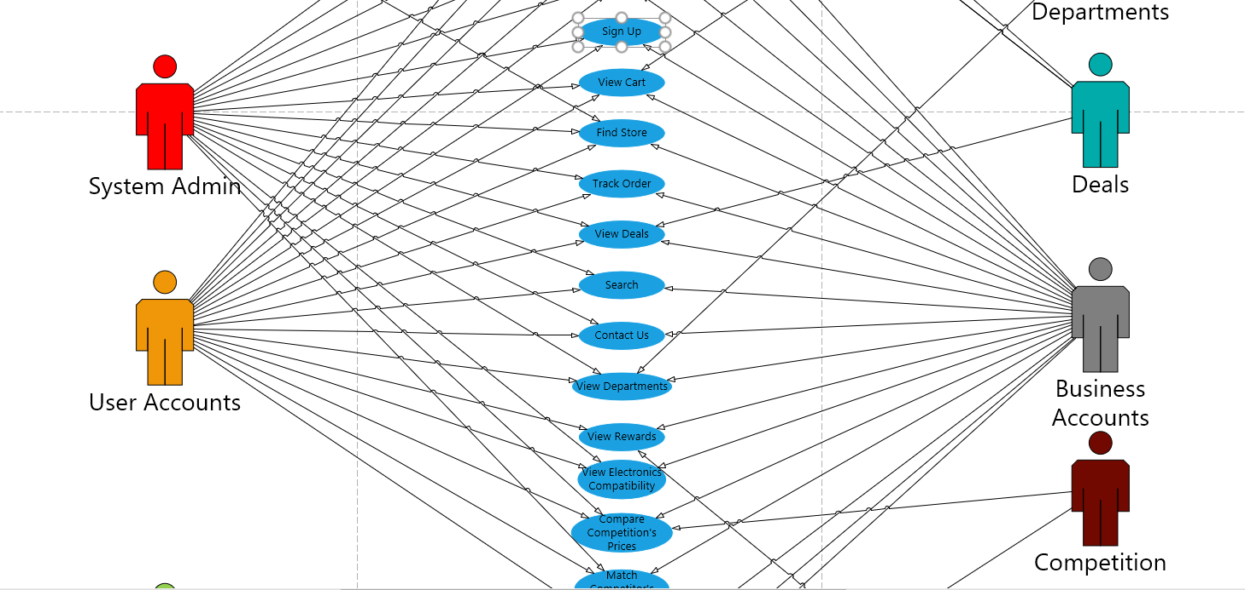
Use Case Part 2
33

Slide 34
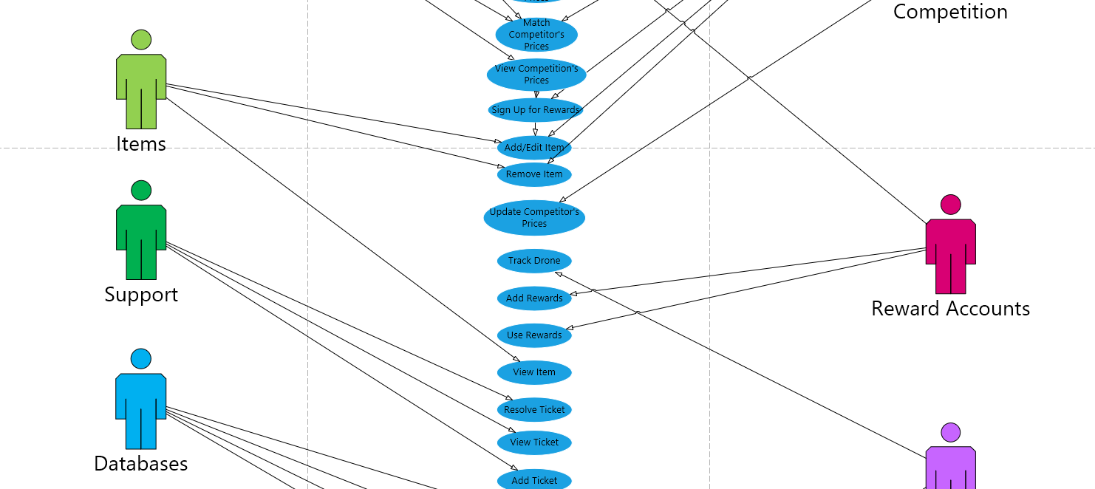
Use Case Part 3
34

Slide 35
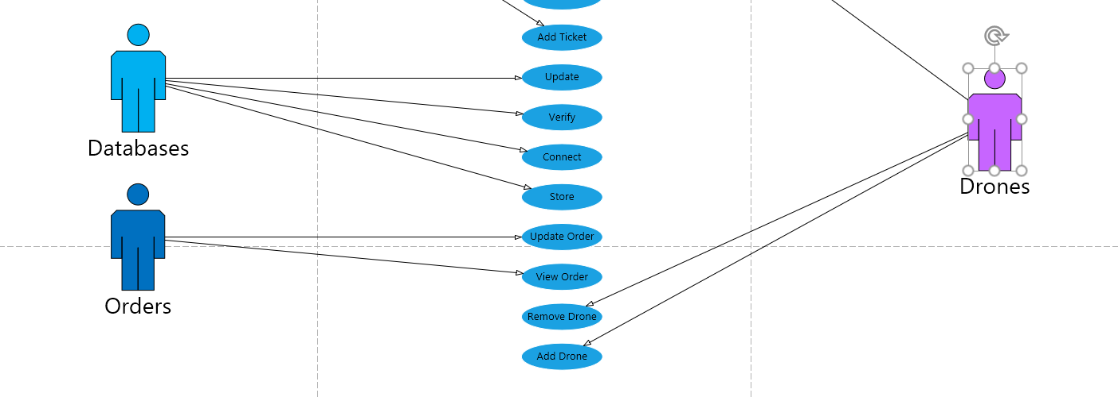
Use Case Part 4
35

Slide 36
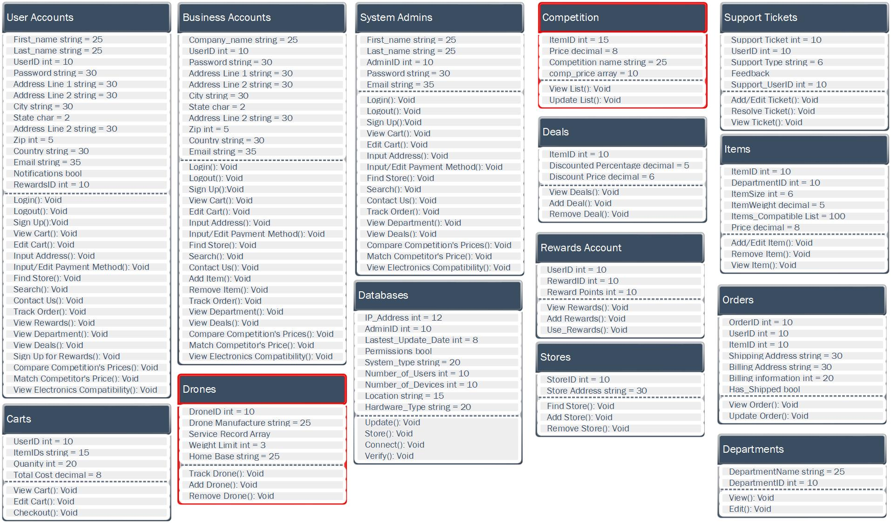
Class Object Diagram
36

Slide 37
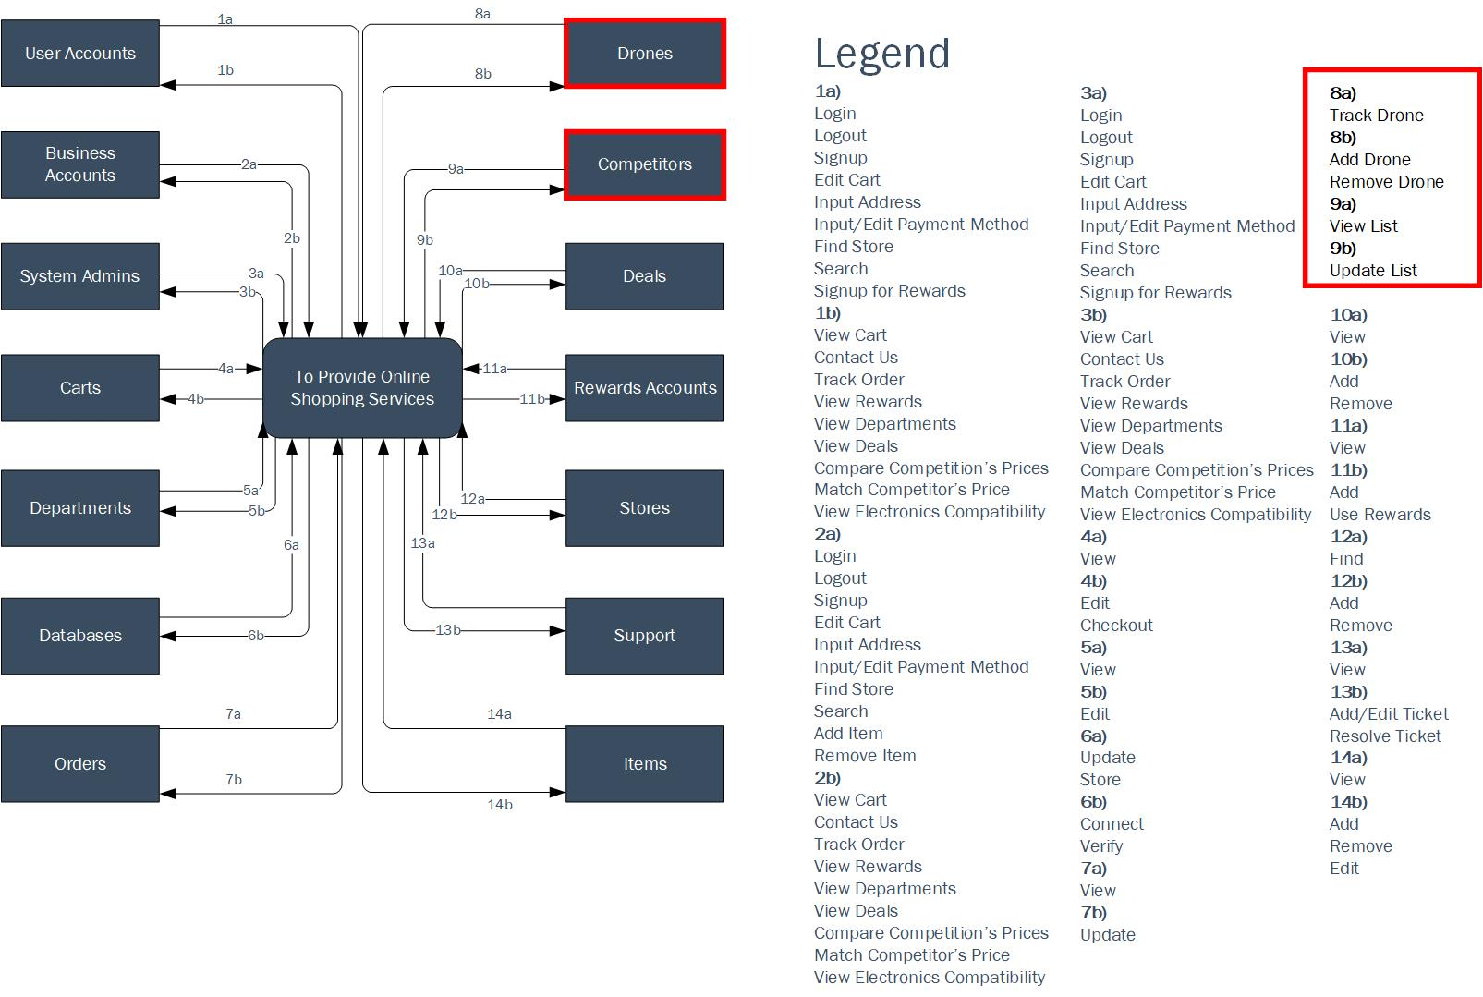
Context Data Flow Diagram
37

Slide 38
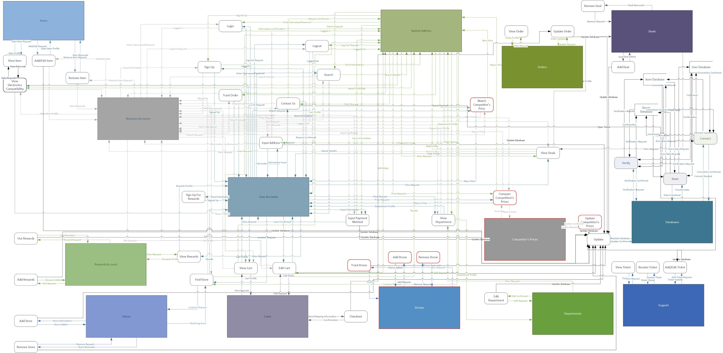
Level-0 Diagram
38

Slide 39
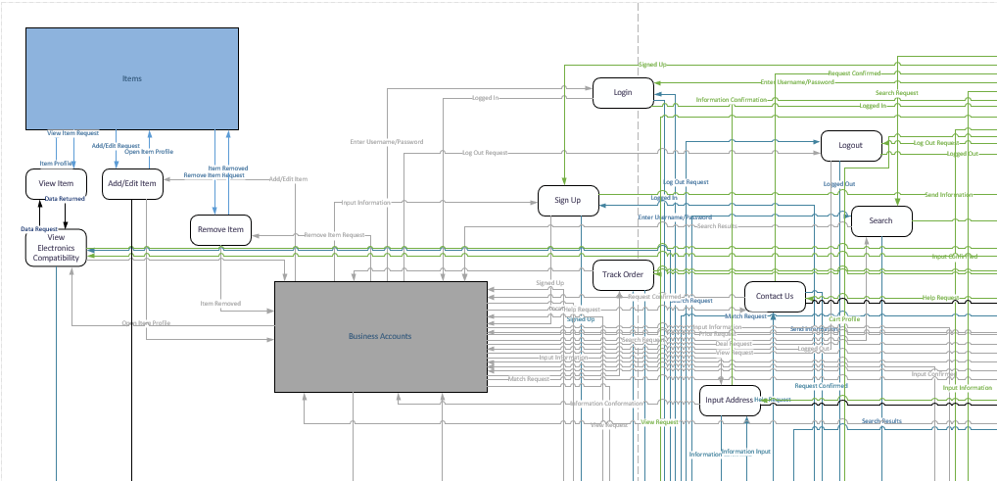
Level-0 Part 1
39

Slide 40
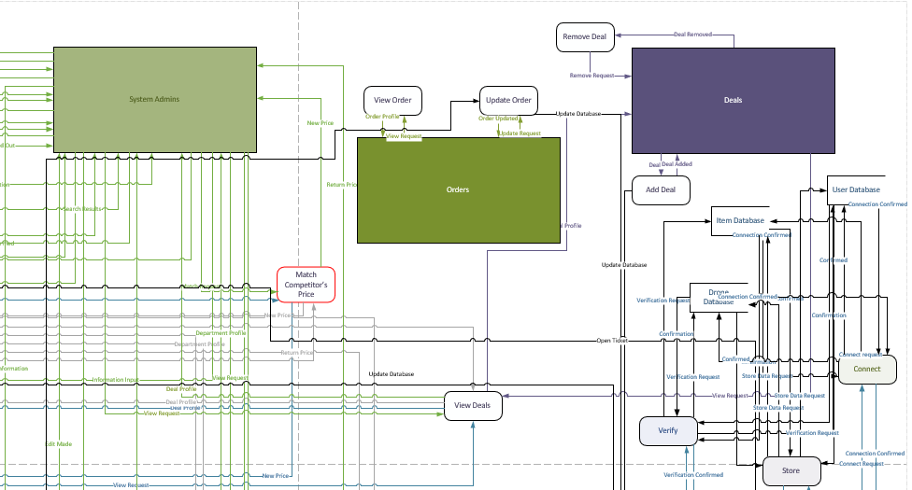
Level-0 Part 2
40

Slide 41
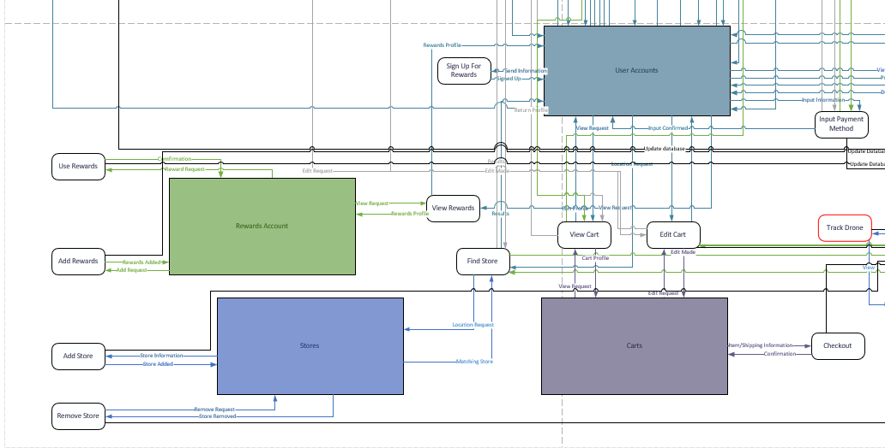
Level-0 Part 3
41

Slide 42
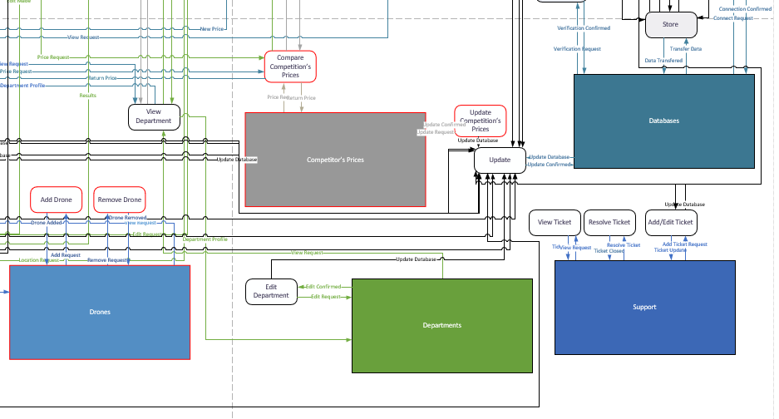
Level-0 Part 4
42

Slide 43
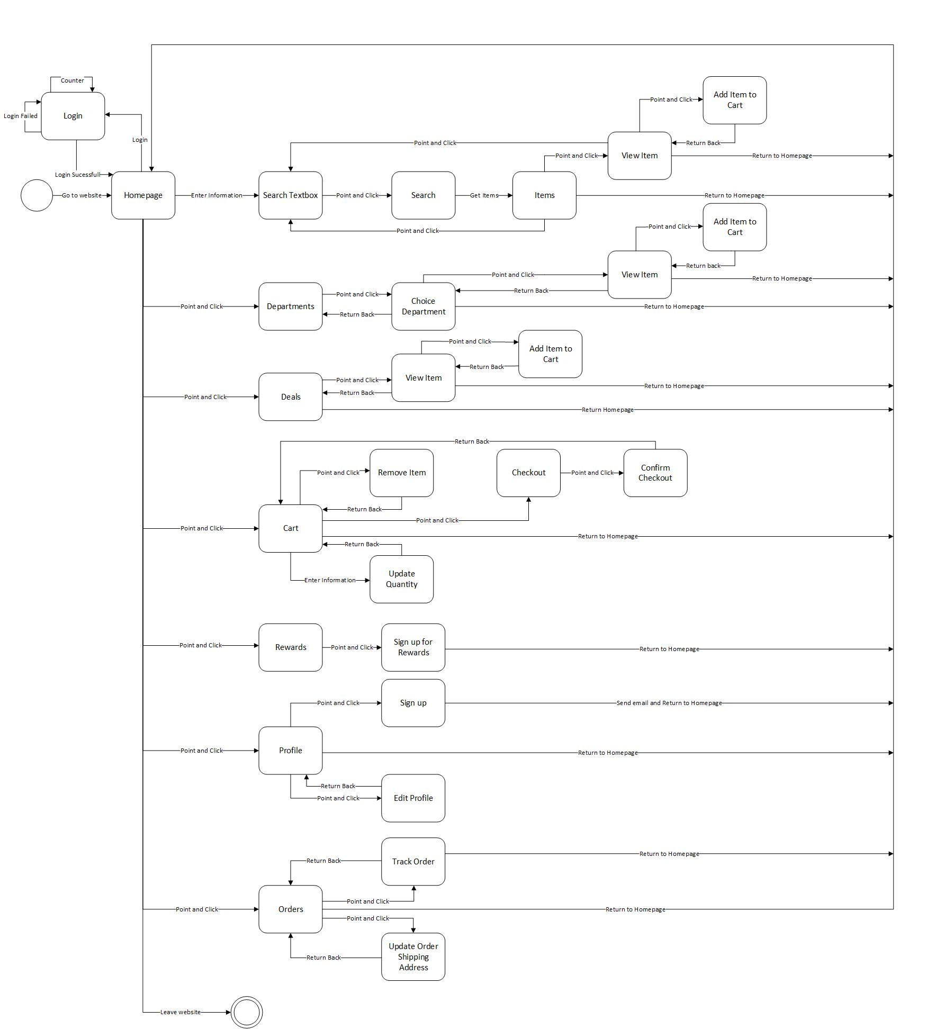
State Transition Diagram
43

Slide 44
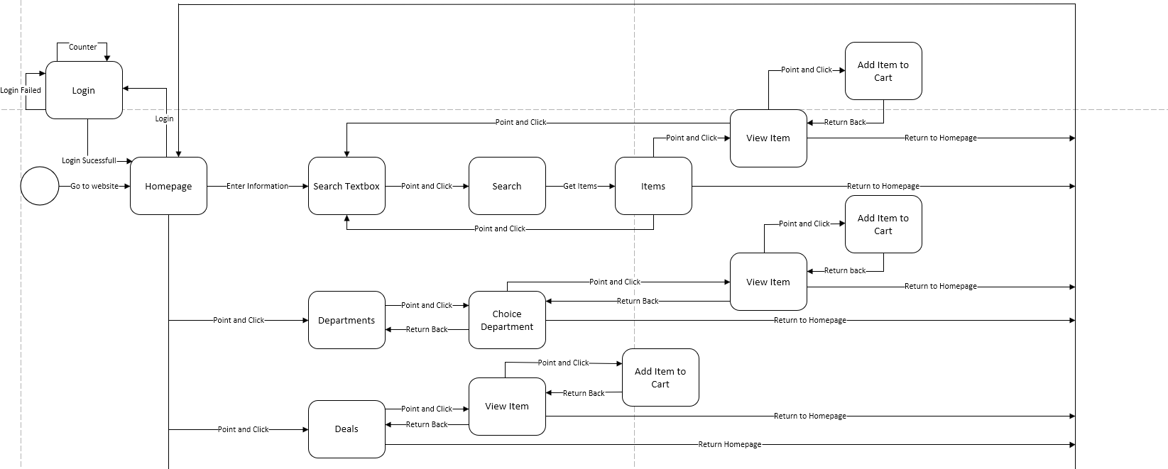
State Transition Diagram Part 1
44

Slide 45
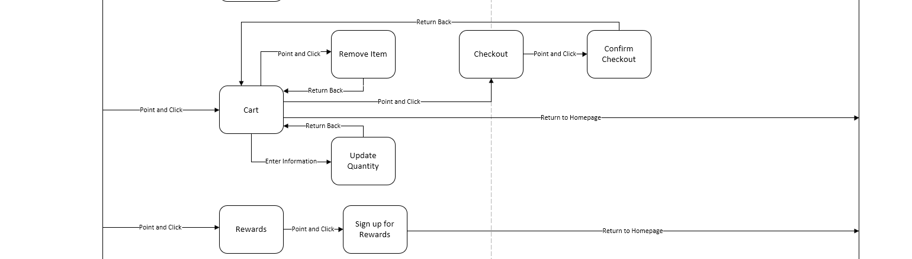
State Transition Diagram Part 2
45

Slide 46
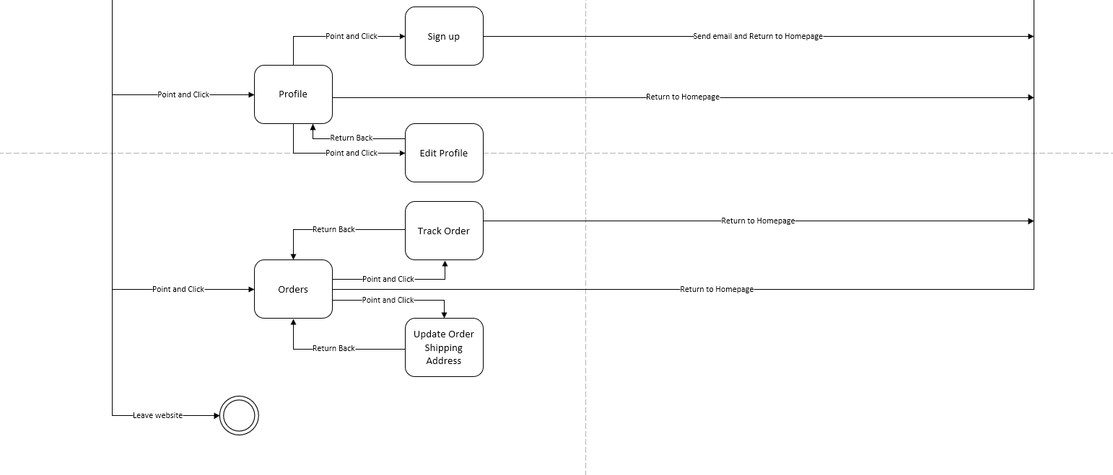
State Transition Diagram Part 3
46

Slide 47
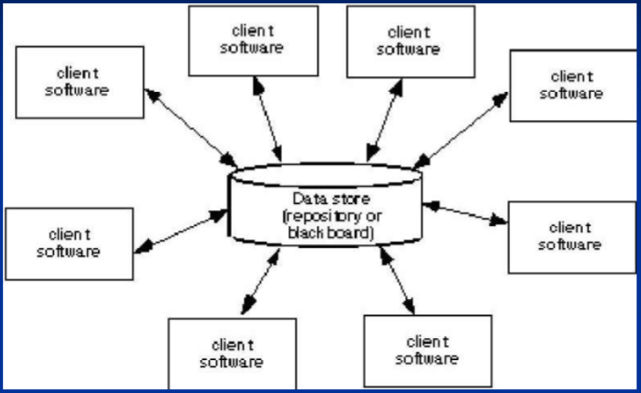
Software Architectural Model: Data Centered
47
All data is stored in one central location.
Customers access the central repository.
Clients can be added and removed without affecting other clients.

Slide 48
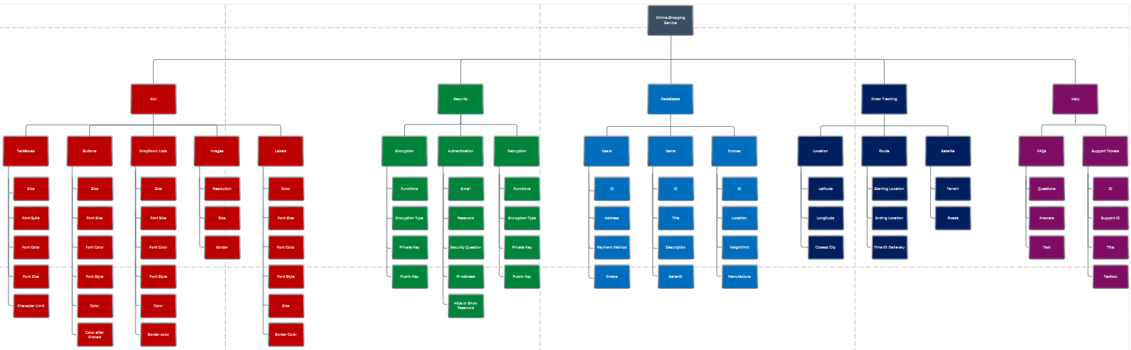
Hierarchical Model
48

Slide 49
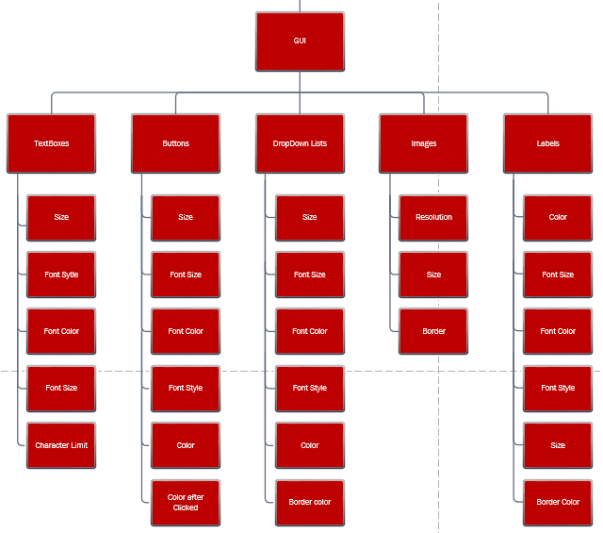
GUI
49

Slide 50
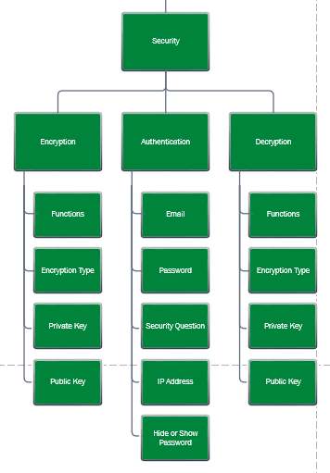
Security
50

Slide 51
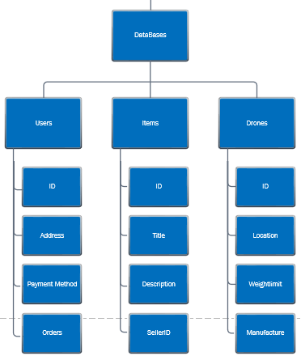
Databases
51

Slide 52
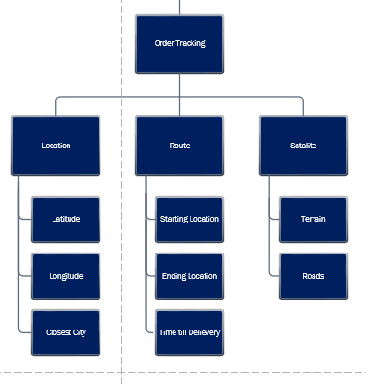
Order Tracking
52

Slide 53
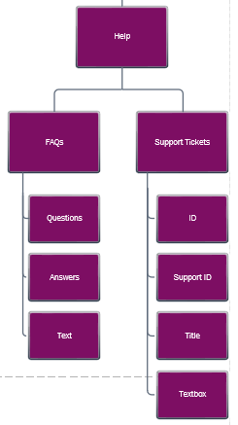
Help
53

Slide 54
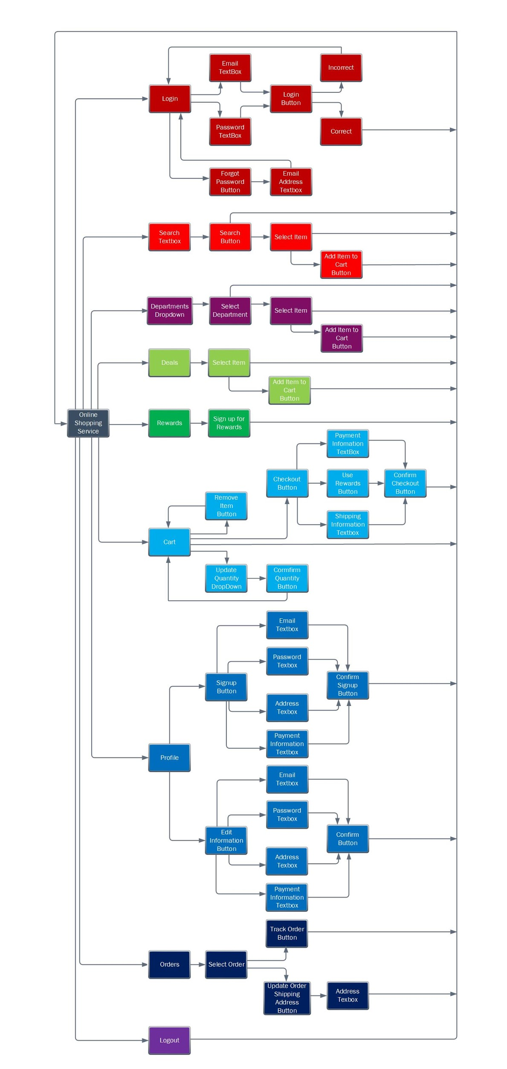
GUI Functional View
54

Slide 55
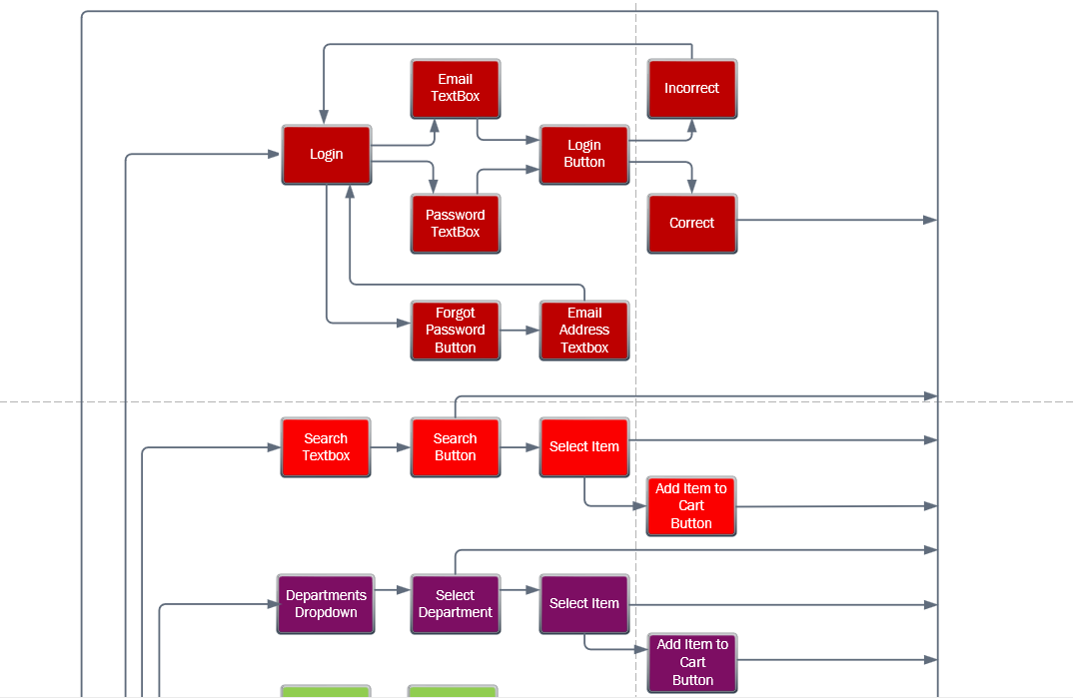
GUI Functional View Part 1
55

Slide 56
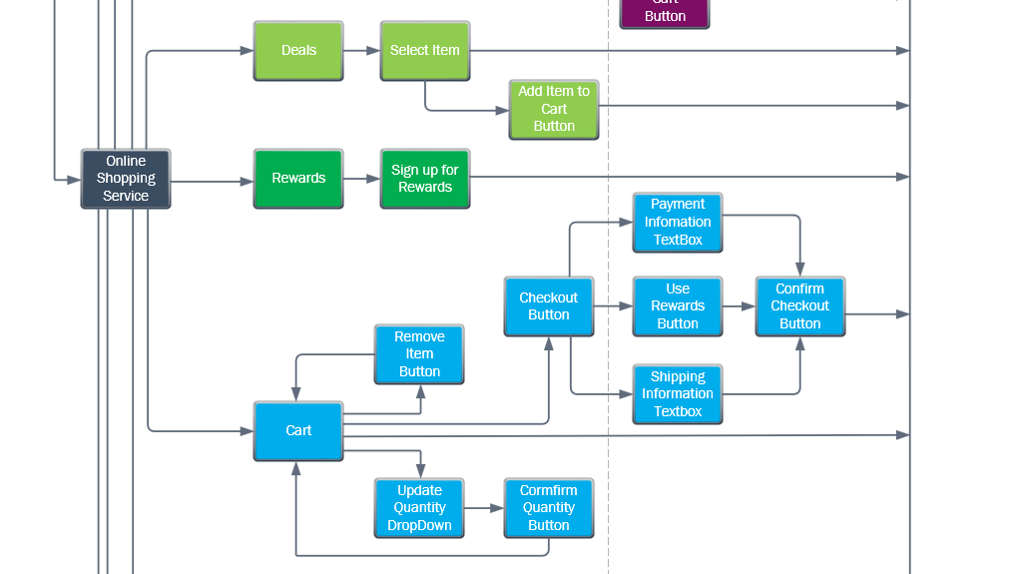
GUI Functional View Part 2
56

Slide 57
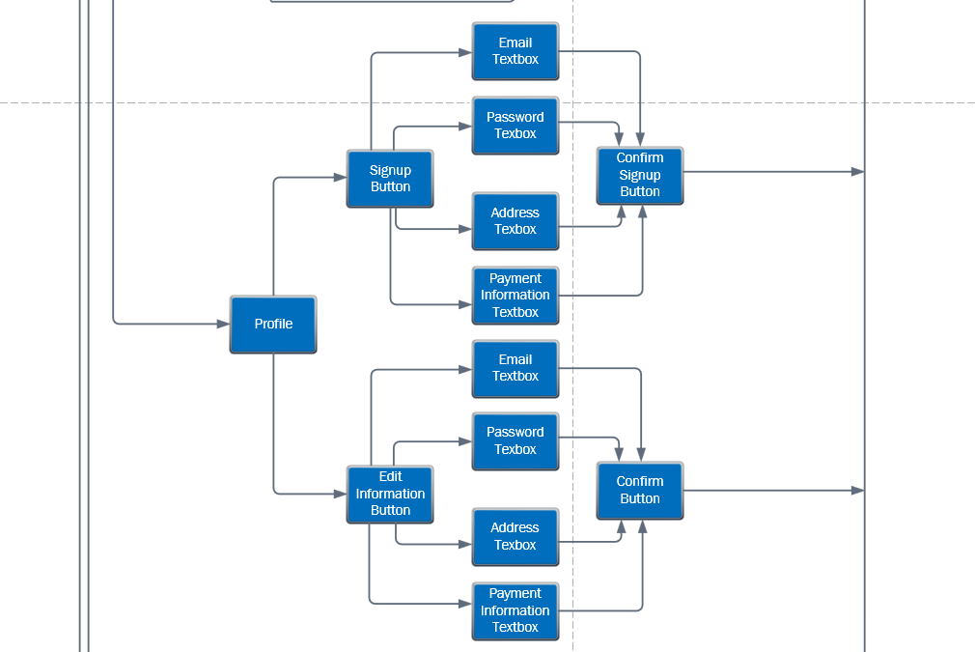
GUI Functional View Part 3
57

Slide 58
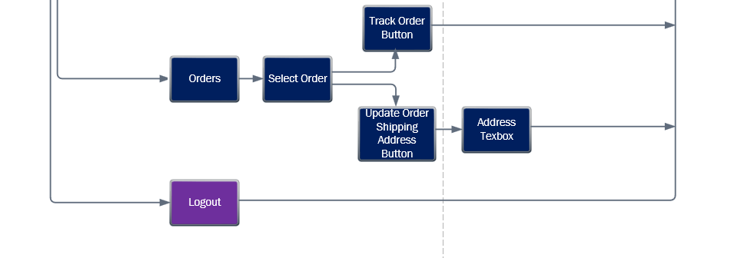
GUI Functional View Part 4
58

Slide 59
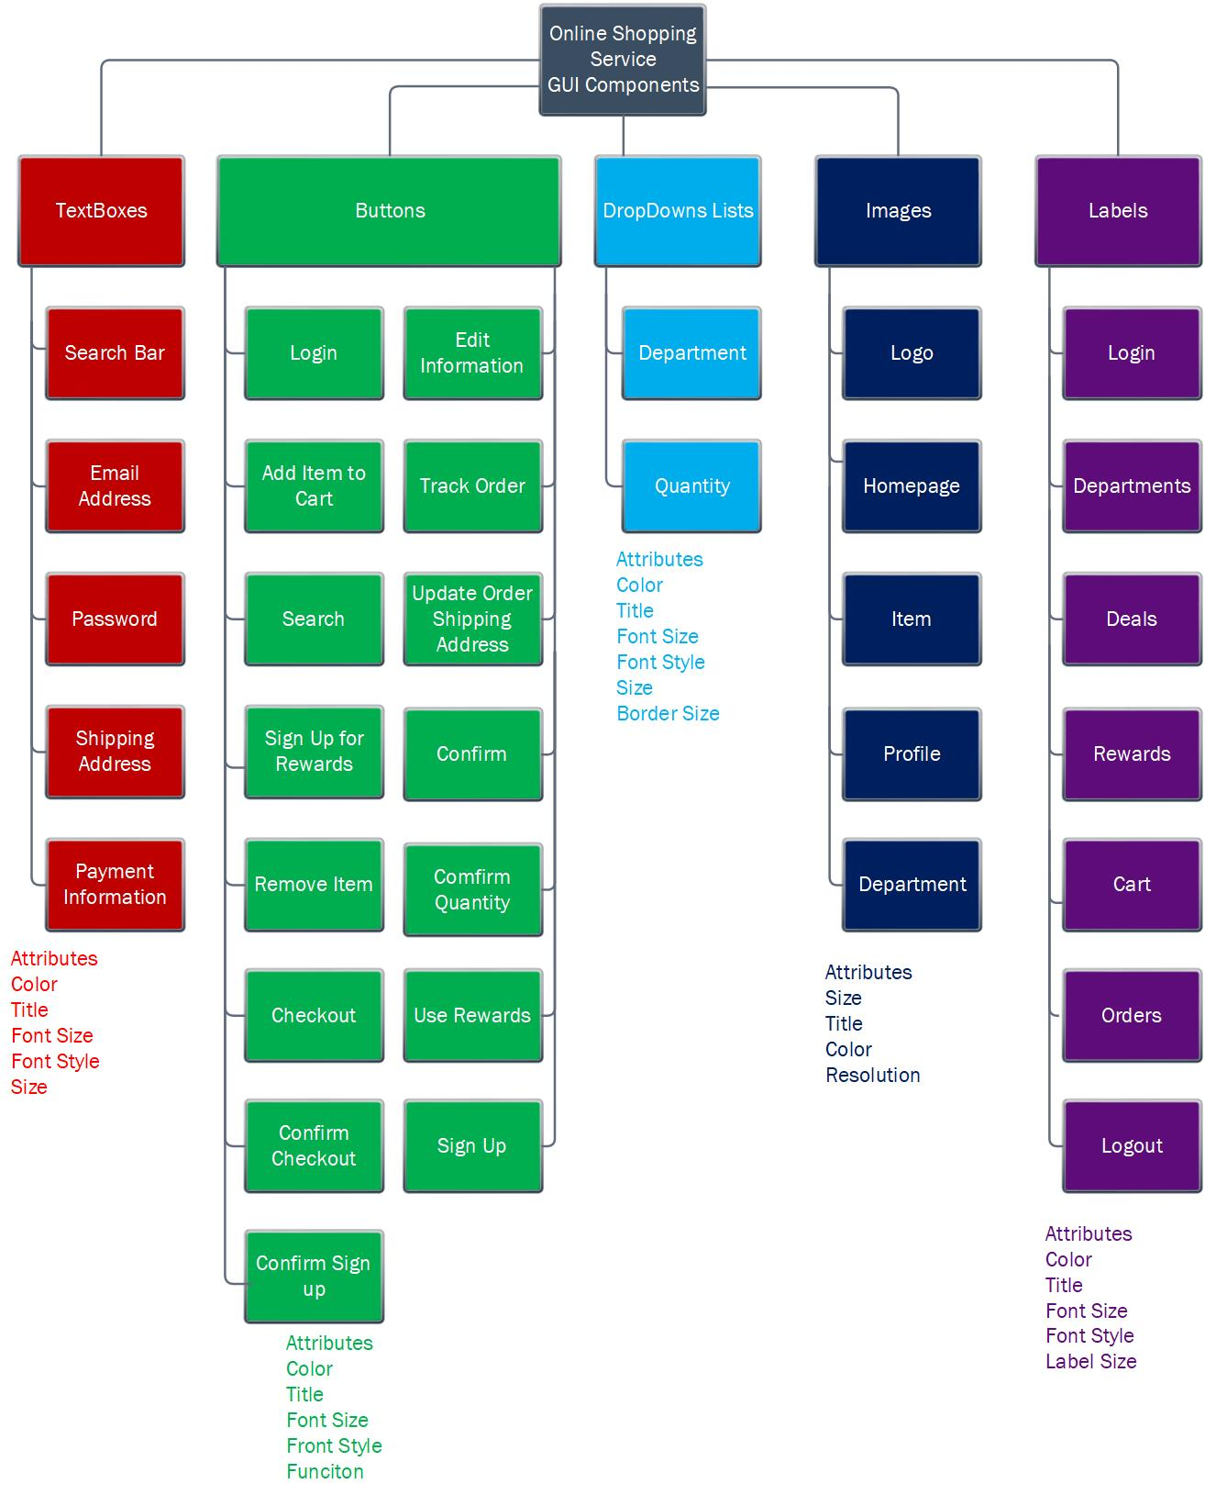
GUI Component View
59

Slide 60
Lines of Code Based Estimation
60
Function System | Estimated LOC
GUI | 5,000
Database Management | 15,000
Drone Location Calculation | 10,000
Drone Route Calculation | 20,000
Total | 50,000

Slide 61
Lines of Code Based Estimation
61
Total Lines of Code: 50,000
Average Lines of Code written per month: 620
Labor Rate per month: $8,000
Total Cost:
81 Man Months
648,000

Slide 62
Function-Point Based Estimation
62
Information Domain Value | Optimal | Most Likely | Pessimistic estimation | Estimated Count | Weight | FP-Count
# of Inputs | 30 | 35 | 40 | 35 | 5 | 140
# of Outputs | 25 | 30 | 35 | 30 | 9 | 120
# of Inquiries | 30 | 40 | 50 | 40 | 9 | 160
# of Files | 10 | 15 | 20 | 15 | 7 | 60
# of External Interfaces | 5 | 8 | 11 | 8 | 6 | 32
Total |  |  |  |  |  | 512

Slide 63
Function-Point Based Estimation
63
Number of Function Points: 512
Average Function Points completed per month: 6.5
Labour Rate per month: $8,000
Total Cost:
79 Man Months
$632,000

Slide 64
Thank You!
64
Team 01 Emily Benson & Nick Hancher

